Slide 1
iRVision Training 3D Area Sensor And Bin Picking SW V8.20P/20

Slide 2
Contents
General Introduction of 3D Area Sensor And Technology
3D Area Sensor Specification And Order Information
Design of the Installation Layout
Software Installation And iRVision Menus Overview
3D Area Sensor Setup And Calibration
Tool Frame And User Frame Setup
Vision Process And Bin Picking Setup
Programming
Appendix

Slide 3
3D Area Sensor Specification And Order Information

Slide 4
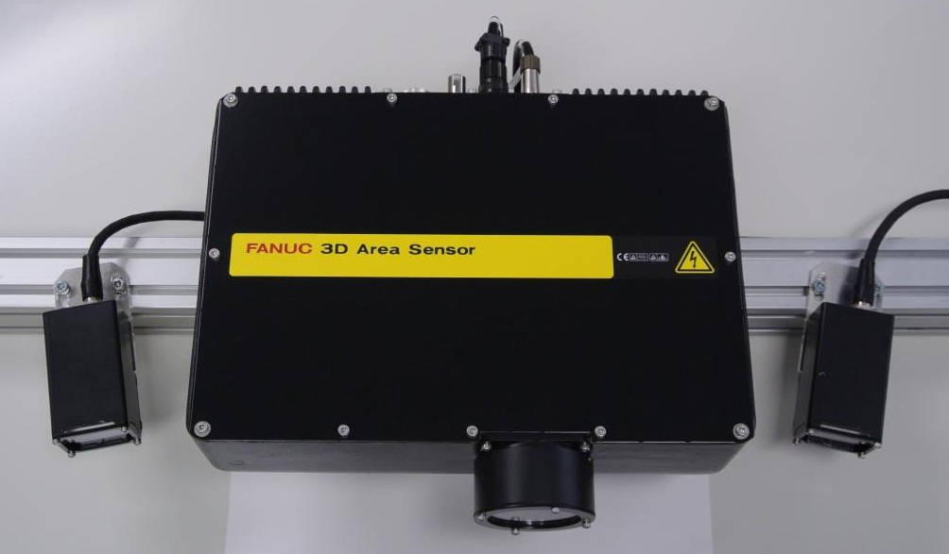
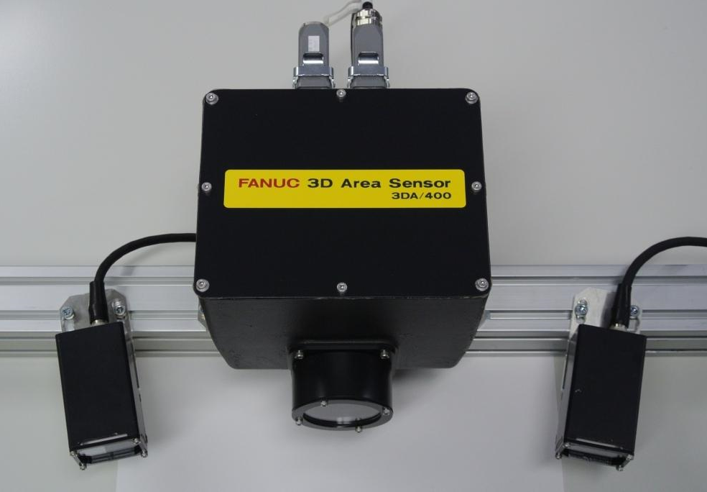
3DAS Types
3DA/1300
3DA/400

Slide 5
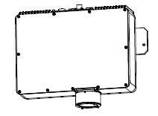
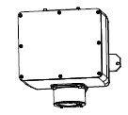
3DAS Key Data
Type | 3DA/1300 | 3DA/400
Projector Appearance
Measurement Range [mm] (W x D x H) | 1340×1000×1000* to 400×300×300 | 400×300×300* to 200×150×150
Measurement Time, Min. Time Between Measurements | 2 ~ 3 sec. (depending on setup), 2 ~ 12 sec (depending on setup)
Measurement Accuracy | XY : ± 0.3 mm Z : ± 2.3 mm (for measurement range 1340×1000×1000) | XY : ± 0.1 mm Z : ± 0.7 mm (for measurement range 400×300×300)
Number of 3D Points | Normal-Density Mode - app. 45000 points (239 × 192) Coarse-Density Mode - app. 11000 points (119 × 96)* Fine-Density Mode - app. 180000 points (479 × 384)*
Number of Sensors | Up to 4 per one robot controller. | Up to 4* per one robot controller. * expected in 2015
Installation Environment | Ambient Temperature : 0 to 45 degrees Celsius Ambient Humidity : Normally max. 75% RH or less (No dew, nor frost allowed) Short term max. 95% RH or less (within one month) Vibration : 0.5G or less
Sensor type should be selected based on required measurement range.
* Even larger Measurement Range is possible with well imaging big parts in a darkened cell
* SW: V8.20P/11 or later & Projector FW: V1.5 or later
Note: 3D/1300 and 3DA/400 can not be connected to the same controller at the same time!

Slide 6
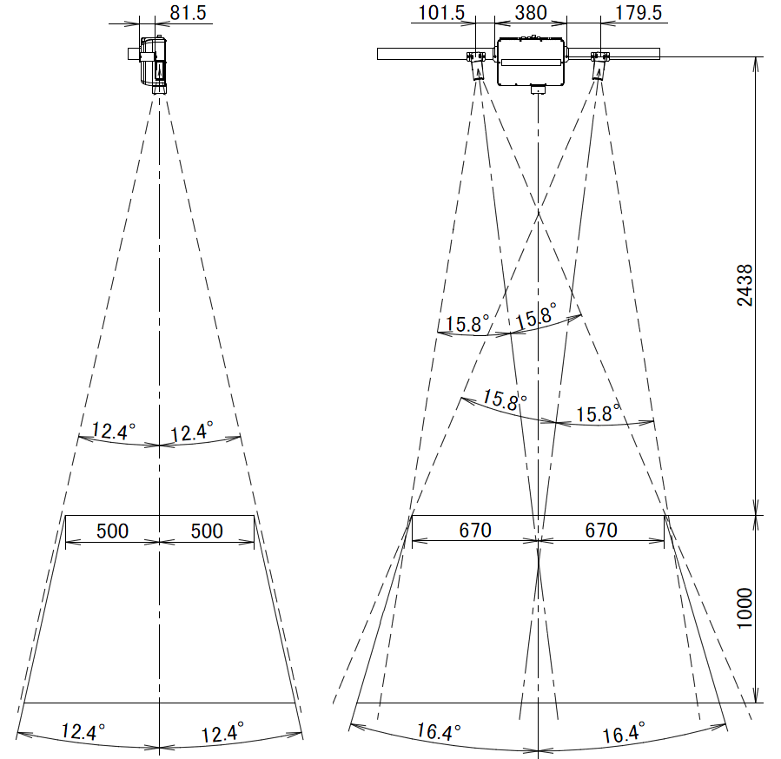
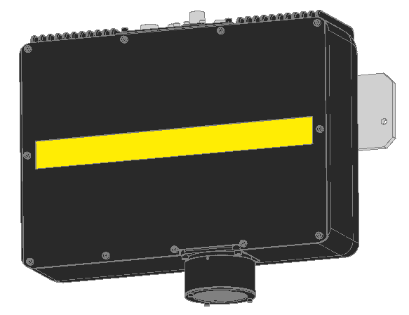
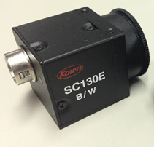
3DA/1300 Mechanical Layout
Standard Mechanical Layout
Projector Unit 3DA/1300
A05B-1422-B103
PU FOV and focus adjustable!
Camera Unit
A05B-1423-H025
*CCU F/W >= "02.01 / 1.15" and MUX F/W >= "0022 / 2.3" required!

Slide 7
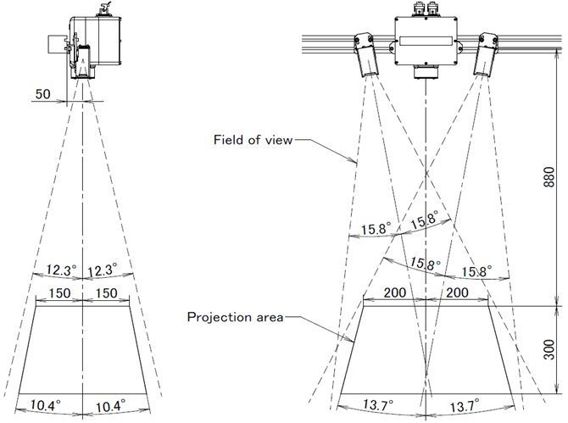
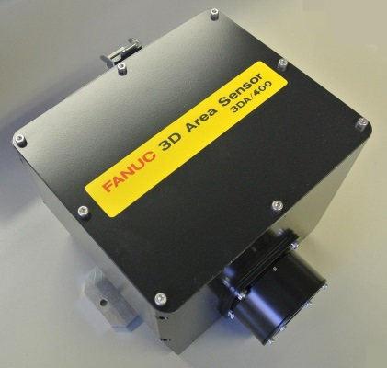
3DA/400 Mechanical Layout
Mechanical Layout
Projector Unit 3DA/400
A05B-1422-B113
3DA/400 FOR SMALL BOXES!
PU FOV and focus adjustable!
Camera Unit
A05B-1423-H025
*CCU F/W >= "02.01 / 1.15" and MUX F/W >= "0022 / 2.3" required!

Slide 8
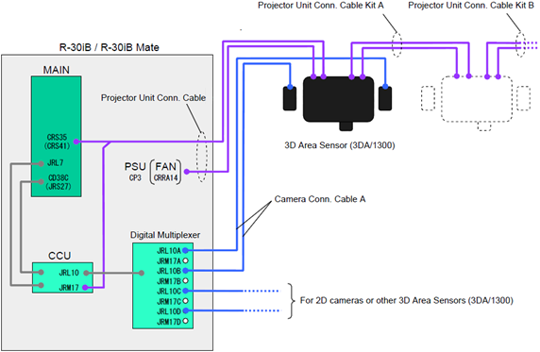
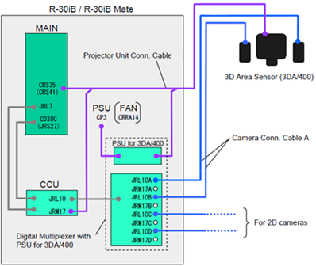
3DAS Electrical Connections
3DA/1300
3DA/400

Slide 9
3DAS & Bin Picking Software
Vision Tools for 3D Area Sensor
Command Tools
For
true 3D
find
Area Sensor
Preprocess Tool
Area Sensor Peak
Locator Tool
Sensor Data
Vision Process
Area Sensor Blob Locator Tool
Area Sensor
GF Locator
Tool
Area Sensor
Cylinder Locator
Tool
3D Area Sensor
Setup Data
3D Area Sensor Vision Process
For
2D+3D
hybrid find
Area Sensor COG
Tool
CALL ACQVAMAP
Found parts data
Area Sensor Plane Tool
(Position, Offset,
Obstruction Measurement Tool
etc
)
Bin Picking Functions
Vision Register
Part List Manager
Pick Position
Reference Position Data
Position Register
part list
Reference Position,
Position to avoid
Vision Offset
interference
Note: Bin picking functions (software option J909) are not needed in case of a depalletizing application!
Interference Avoidance
Object Data of the robot
KAREL programs:
IMSEARCH
Object Data of the container
IMPOP
and other objects
IMGETPICKPOS
IMSETSTAT

Slide 10
Order Information
Order list mainly depends on
3D Area Sensor type (3DA/1300, 3DA/400) and quantity
Robot controller and cabinet type (Mate, A, A+Top Box, A+Side Box, B)
Cable length (7, 14, 20, 25) and type (standard, flexible)
Please refer to the ORDERLIST in Excel for possible BOM configurations.

Slide 11
Design of the Installation Layout

Slide 12
Design of the Installation Layout
Before the actual mechanical installation, the layout should be designed. Procedure:
Calculate minimum required FOV and select suitable 3DAS type (3DA/1300 or 3DA/400)
Calculate minimum required mounting height of the PU
Calculate mounting position range for CUs
Ensure flexible position adjustment around calculated mounting position!
Abbreviations:
FOV: Field of View
PU: Projector Unit
CU: Camera Unit
3DAS: 3D Area Sensor

Slide 13
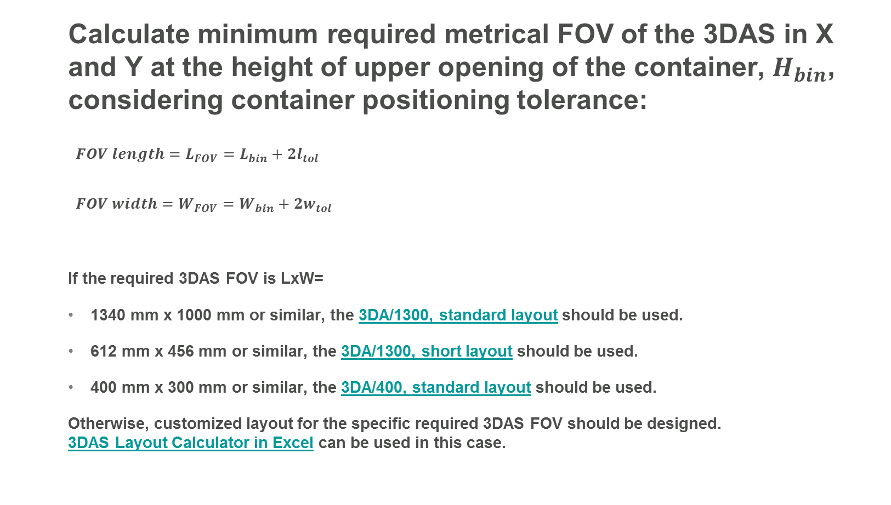
Design of the Installation Layout
Calculate minimum required metrical FOV of the 3DAS in X and Y at the height of upper opening of the container, $H_{bin}$, considering container positioning tolerance:
$FOV length=L_{FOV}=L_{bin}+2l_{tol}$
$FOV width=W_{FOV}=W_{bin}+2w_{tol}$
If the required 3DAS FOV is LxW=
1340 mm x 1000 mm or similar, the 3DA/1300, standard layout should be used.
612 mm x 456 mm or similar, the 3DA/1300, short layout should be used.
400 mm x 300 mm or similar, the 3DA/400, standard layout should be used.
Otherwise, customized layout for the specific required 3DAS FOV should be designed. 3DAS Layout Calculator in Excel can be used in this case.

Slide 14
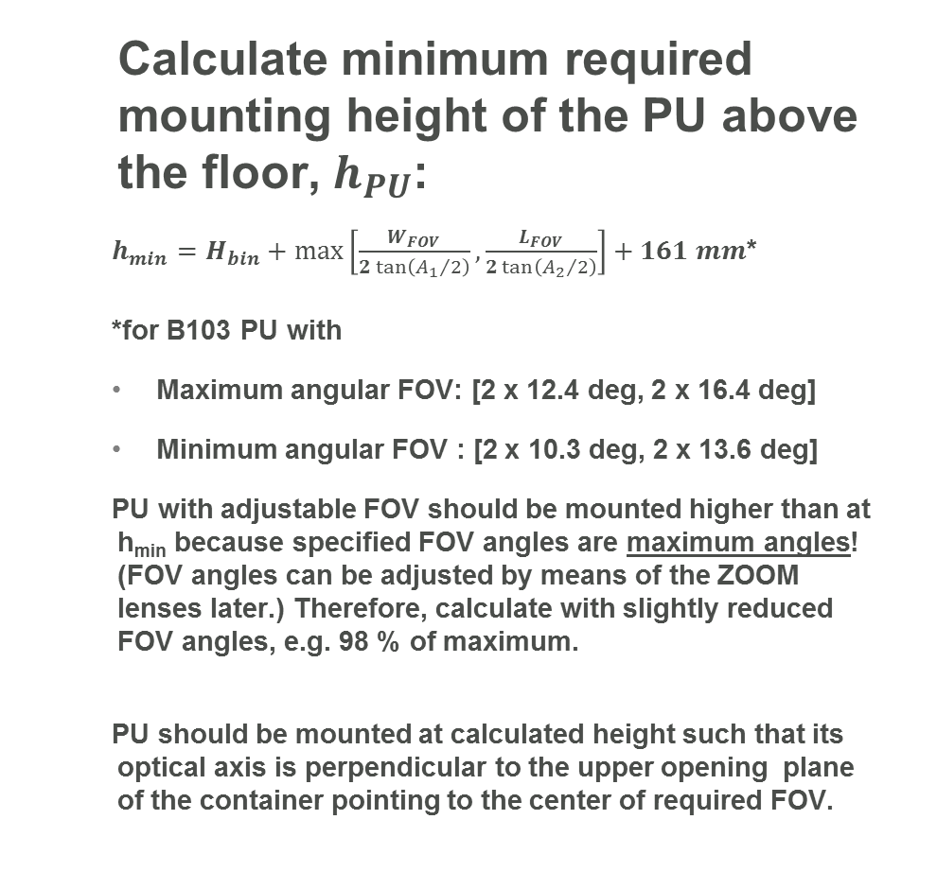
Design of the Installation Layout
Calculate minimum required mounting height of the PU above the floor, $h_{PU}$:
$h_{min}=H_{bin}+\max_{}\left[\frac{W_{FOV}}{2\tan\left({A_{1}}/2\right)},\frac{L_{FOV}}{2\tan\left({A_{2}}/2\right)}\right]+161 mm$*
*for B103 PU with
Maximum angular FOV: [2 x 12.4 deg, 2 x 16.4 deg]
Minimum angular FOV : [2 x 10.3 deg, 2 x 13.6 deg]
PU with adjustable FOV should be mounted higher than at h_{min} because specified FOV angles are maximum angles! (FOV angles can be adjusted by means of the ZOOM lenses later.) Therefore, calculate with slightly reduced FOV angles, e.g. 98 % of maximum.
PU should be mounted at calculated height such that its optical axis is perpendicular to the upper opening plane of the container pointing to the center of required FOV.
Front view
Top view

Slide 15
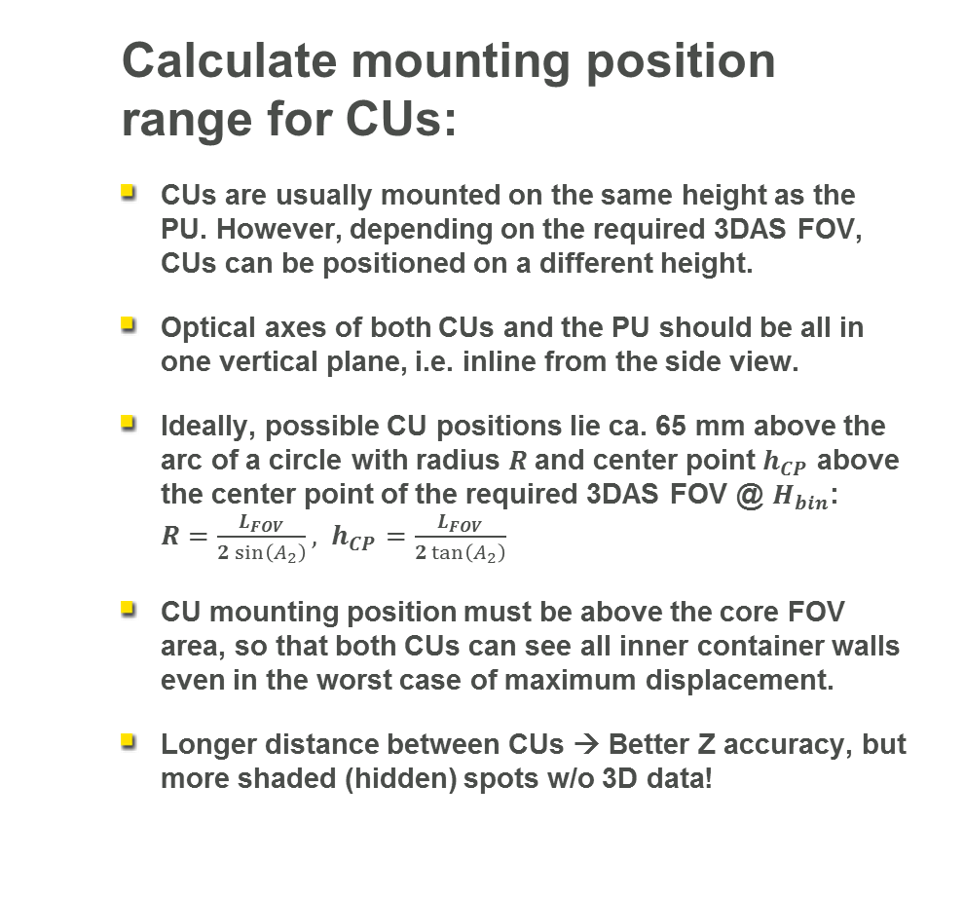
Design of the Installation Layout
Calculate mounting position range for CUs:
CUs are usually mounted on the same height as the PU. However, depending on the required 3DAS FOV, CUs can be positioned on a different height.
Optical axes of both CUs and the PU should be all in one vertical plane, i.e. inline from the side view.
Ideally, possible CU positions lie ca. 65 mm above the arc of a circle with radius $R$and center point $h_{CP}$ above the center point of the required 3DAS FOV @ $H_{bin}$: $R=\frac{L_{FOV}}{2\sin\left(A_{2}\right)}, h_{CP}=\frac{L_{FOV}}{2\tan\left(A_{2}\right)}$
CU mounting position must be above the core FOV area, so that both CUs can see all inner container walls even in the worst case of maximum displacement.
Longer distance between CUs → Better Z accuracy, but more shaded (hidden) spots w/o 3D data!
Front view
Top view

Slide 16
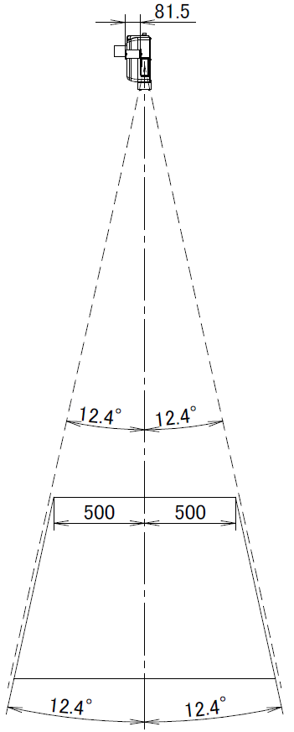
Design of the Installation Layout
Two bins per one 3DAS also possible!
Recommendations:
Bins must be rotated by ~6.2 deg around longer upper wall rim towards the cameras to avoid shaded areas at the connecting walls inside the boxes!
The connecting wall rims should tightly touch each other.
Position of the bins should be fixed and constant.
Bins should be of the same type and size.
Bins should not be square.
Bins should not be large. Recommended maximum: ca. 800 mm x 600 mm. Otherwise, only feasible with big, well imaging parts and if robot cell is shaded from outside lights.
3D Area Sensor
Lateral FOV
6.2°
2 tilted bins

Slide 17
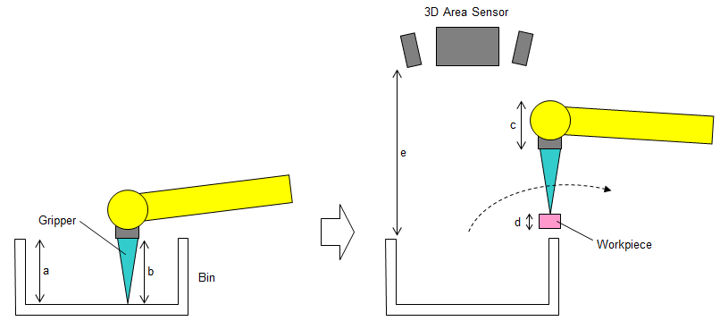
Design of the Installation Layout
Other considerations to be taken into account:
Find suitable positions of the bin and robot to ensure good approachability and reachability of workpieces and to prevent singularities inside the working area, e.g. wrist singularity (J5 = 0).
Consider general relationship between bin height, sensor stand off, robot type and workpiece size:
Generally, gripper length "b" >= bin depth "a"
Sensor stand off "e" > "b" + "c" + "d".

Slide 18
Software Installation

Slide 19
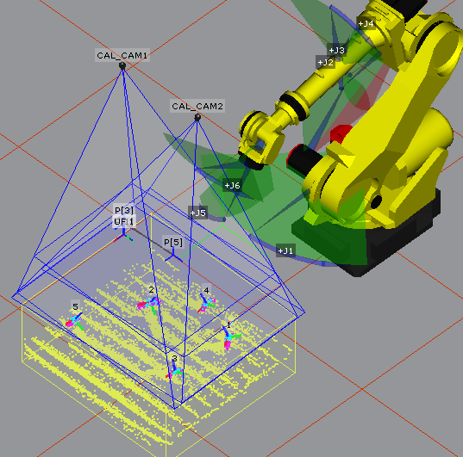
Software Installation
Mandatory SW options to be included in ORDERFIL.DAT:
J871 – iRVision UIF Controls (Vision Controls)
J873 – Vision Support Tools
J901 – iRVision 2DV
J909 – iRVision Bin Picking
J913 – iRVision 3D Area Sensor
Optional SW:
R792 – Singularity Avoidance
J921 – Touch Skip
R764 – 4D Graphics
Not needed for depalletizing application!
4D Graphics

Slide 20
iRVision Menus Overview

Slide 21
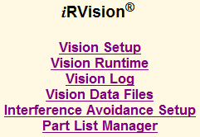
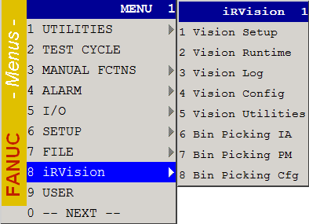
iRVision Menus Overview
iRVision Menus available on iPendant and from PC
Only if software option J909 was also installed!

Slide 22
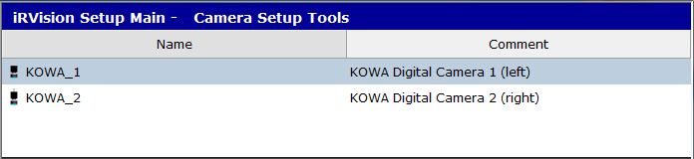
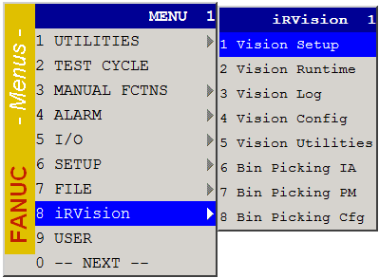
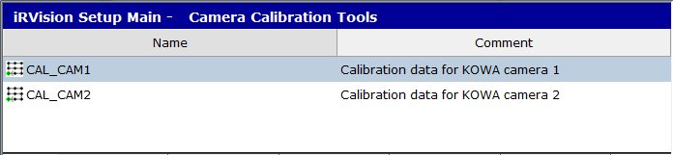
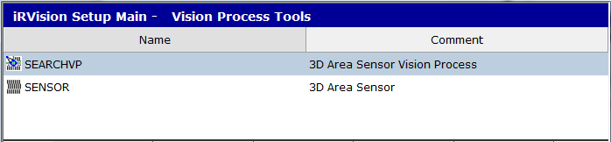
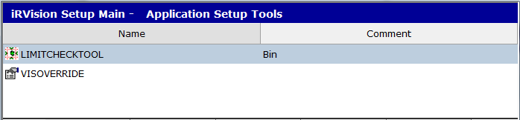
Vision Setup
Create, teach and test vision data

Slide 23
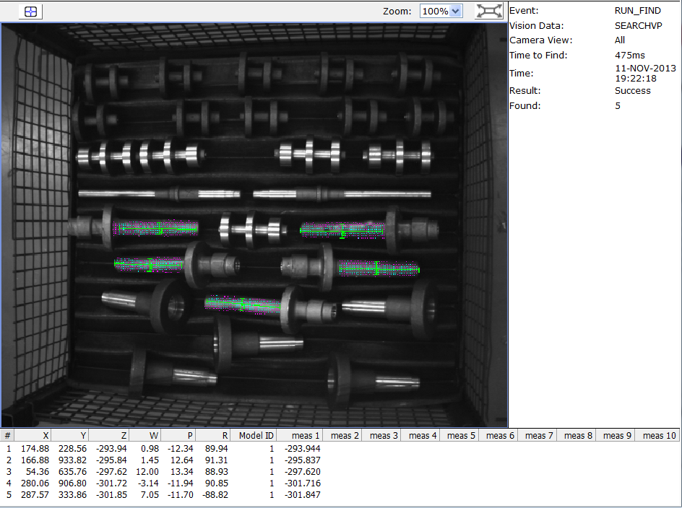
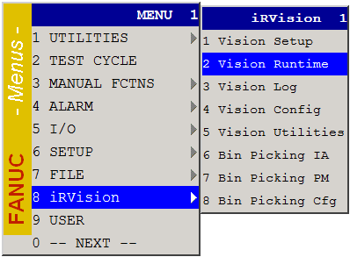
Vision Runtime
Monitor execution of vision processes during production

Slide 24
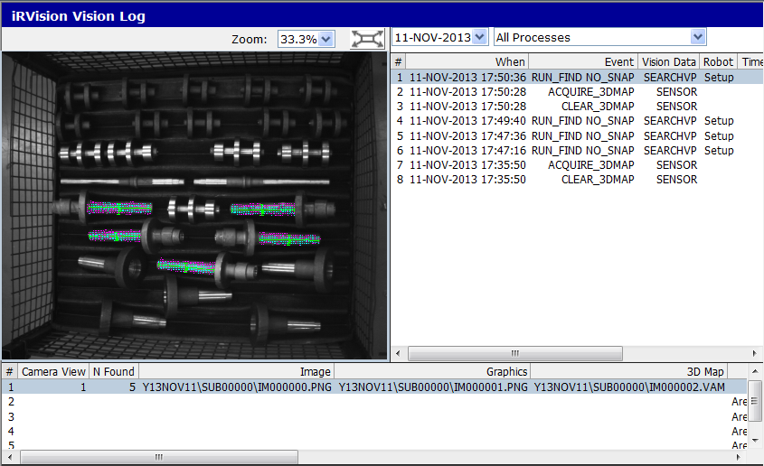
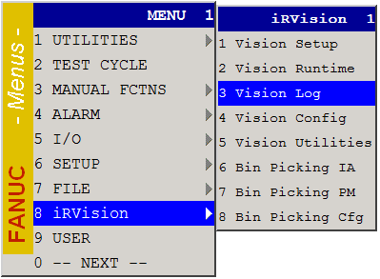
Vision Log
View recorded vision logs

Slide 25
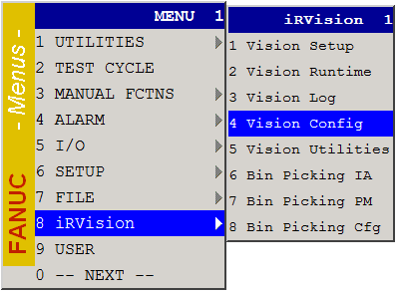
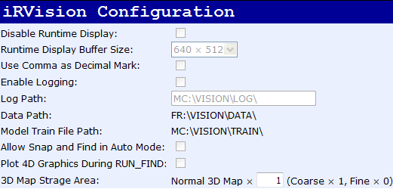
Vision Configuration
Set system variables related to iRVision
DRAM allocation for (simultaneous) storage of one or more 3D maps
Default: 1 (1 normal 3D map or 1 coarse-density 3D map)
Calculate and set a higher integer value, if necessary, e.g. “4” to store {1 fine-density 3D map} OR {4 normal or coarse 3D maps}. Reboot.
Note: Projector firmware version 1.5 or later and SW V8.20P/11 or later is required to support the fine-density and coarse-density modes.

Slide 26
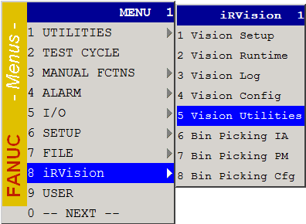
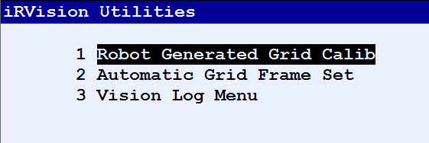
Vision Utilities
Use functions that help you operate iRVision

Slide 27
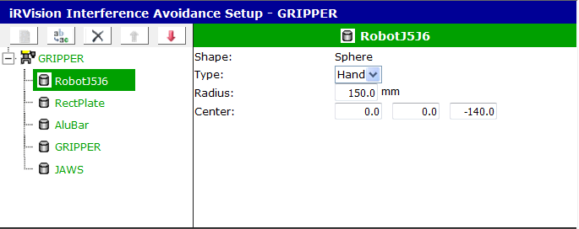
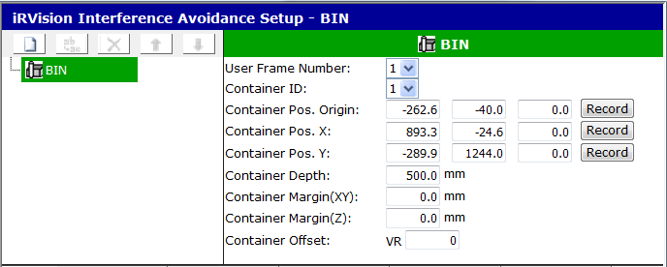
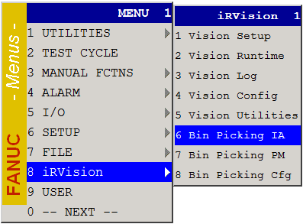
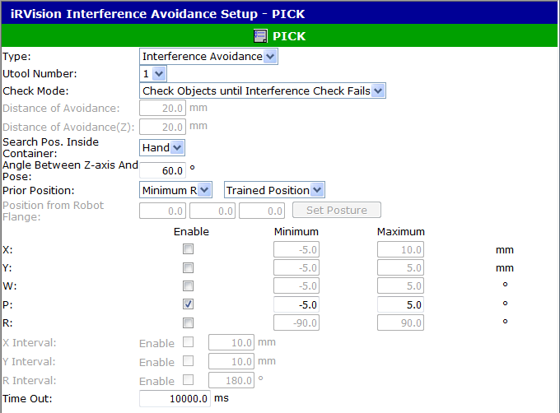
Bin Picking – Interference Avoidance
Set up IA function for Bin Picking
Robot
System
Condition
Only if software option J909 was also installed!

Slide 28
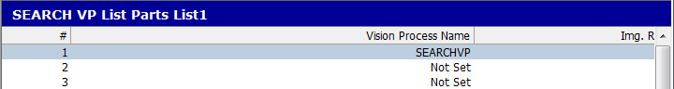
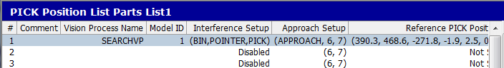
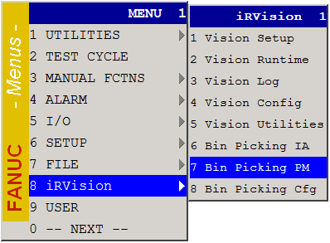
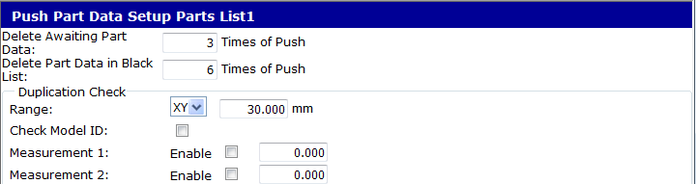
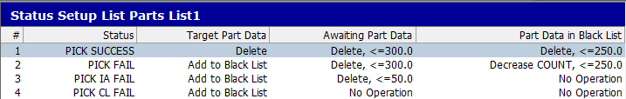
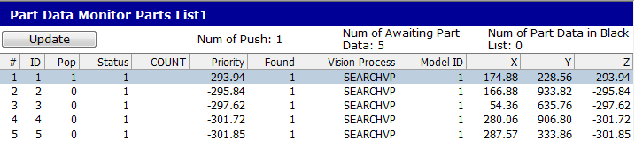
Bin Picking – Parts List Manager
Set up Parts List Manager function for Bin Picking
Only if software option J909 was also installed!

Slide 29
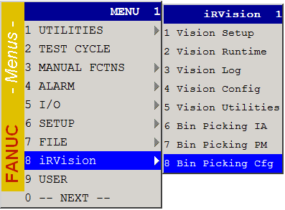
Bin Picking – Configuration
Define max. number of data sets for IA and PM functions
Only if software option J909 was also installed!

Slide 30
3D Area Sensor Setup And Calibration

Slide 31
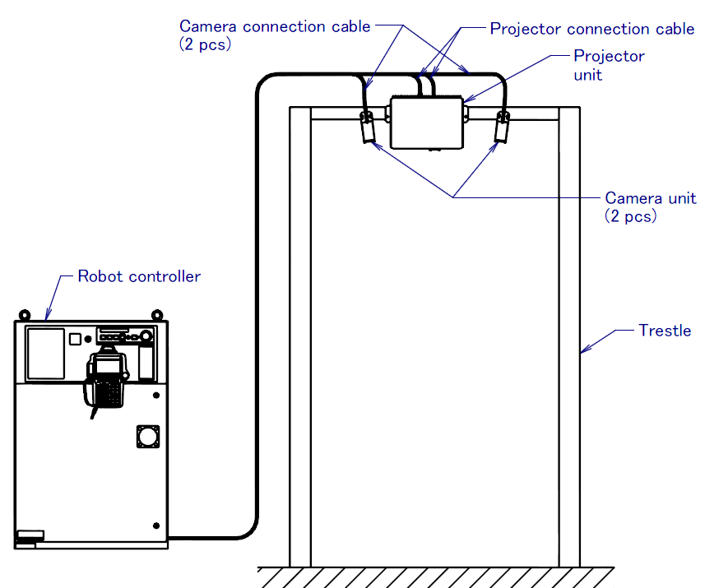
3D Area Sensor Setup And Calibration
Procedure Overview
Prepare a suitable stable mounting structure for 3DAS
Mount PU and both CUs at calculated positions
Connect cables
Check electrical connections and operation
Adjust layout, set up and calibrate 3DAS
Please ensure you understand the 3DAS Technology / 3D Map Acquisition!

Slide 32
3D Area Sensor Setup And Calibration
Electrical Connections
3DA/1300
3DA/400
24 V distribution unit

Slide 33
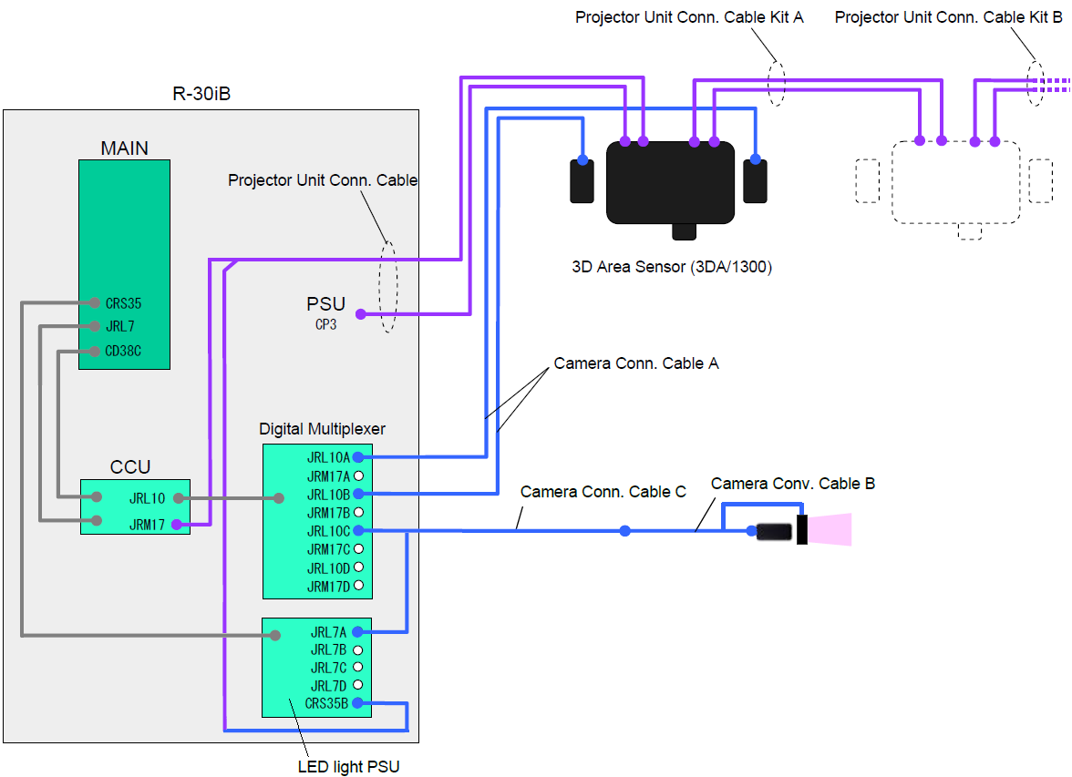
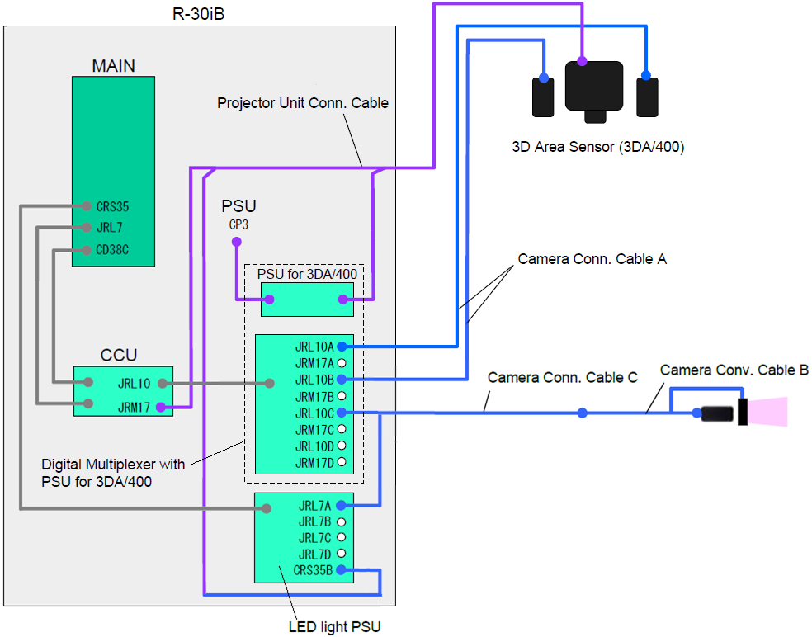
3D Area Sensor Setup And Calibration
Electrical Connections If Camera Package Is Also Used
3DA/1300
3DA/400

Slide 34
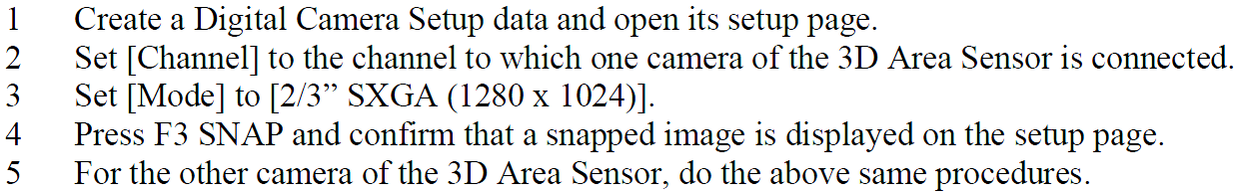
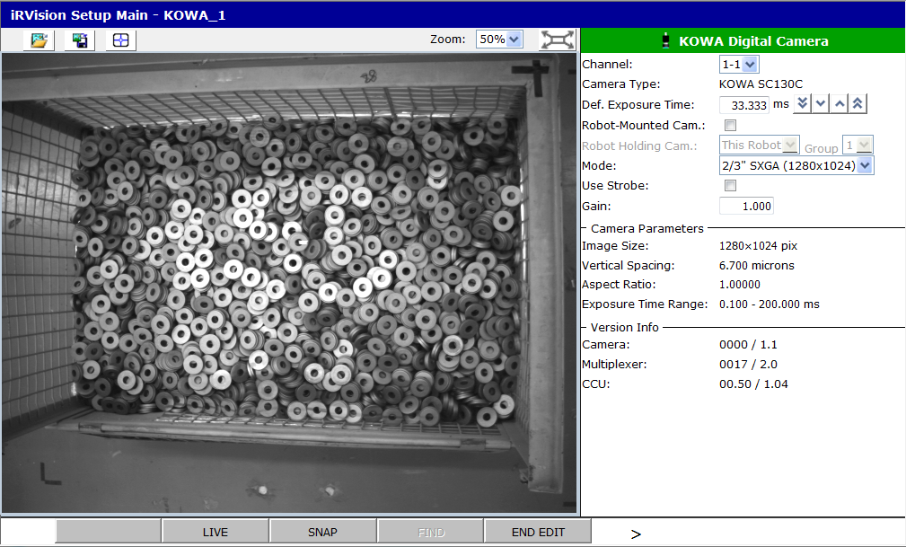
3D Area Sensor Setup And Calibration
Connection & Operation Check Using iRVision Setup (1)
Camera check:
Mode: [2/3” SXGA (1280 x 1024)], if KOWA SC130C
Mode: [1/2” SXGA (1280 x 1024)], if KOWA SC130E

Slide 35
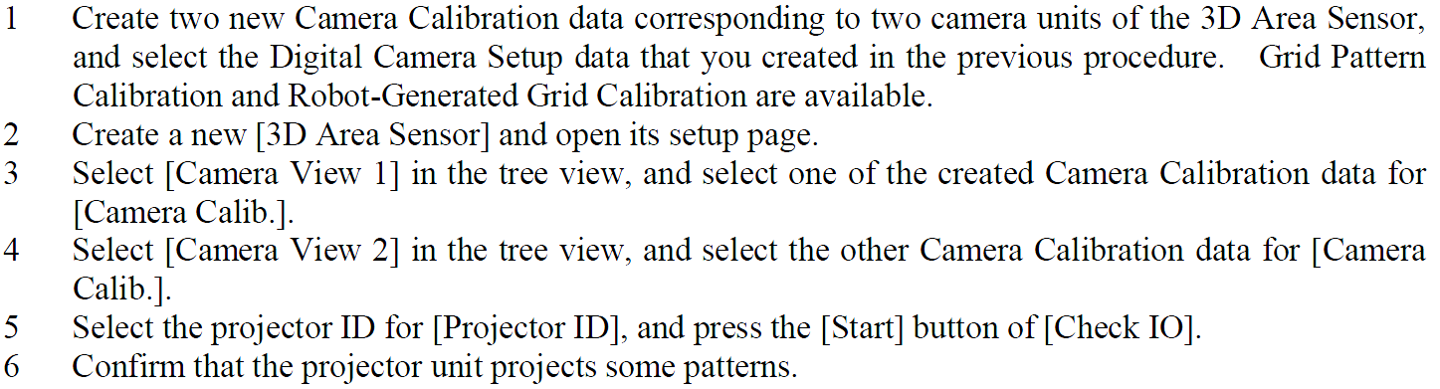
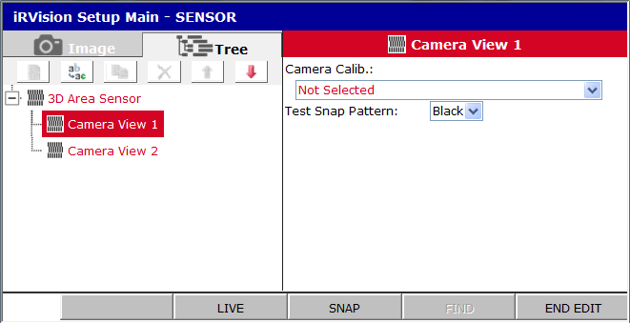

3D Area Sensor Setup And Calibration
Connection & Operation Check Using iRVision Setup (2)
Projector check:
Use Robot-Generated Grid Calibration!
Confirm that “NG” has turned to “OK”!
1.
5.
3.
4.
2.

Slide 36


3D Area Sensor Setup And Calibration
Layout Adjustment, 3DAS Setup and Calibration (1)
Open [3D Area Sensor] setup page. Set [Test Snap Pattern] = [Frame] and turn [PRJ ON]. Now, adjust PU FOV position by moving 3DAS or container so that PU optical axis intersects container center.
With [Test Snap Pattern] = [White], adjust PU FOV size to the required size by using the PU zoom lens or by adjusting PU mounting height. Tip: Put a large, bright, plane cardboard or wooden plate – if available – on top of the container to check current PU FOV size at this height.
With [Test Snap Pattern] = [Stripe], adjust PU focus so that the pattern is sharply projected at 50-60% height of the maximum parts stack height. Tips: Put a small bright plate in the middle of the container, perpendicular to the PU optical axis. Adjust PU focus in darkness.
Position the plate at the calculated height of the axes intersection point. Select Camera View 1, [Test Snap Pattern] = [Frame]. Adjust orientation of the CU1 so that its optical axis intersects with PU optical axis in the center of the projected pattern. (See picture). Do the same with CU2.
Frame pattern
CU1 FOV
CU2 FOV

Slide 37

3D Area Sensor Setup And Calibration
Layout Adjustment, 3DAS Setup and Calibration (2)
Take the plate (used in the previous step) and other foreign things away of the container, so only workpieces stay in.
Adjust CU aperture (often it is best to open it completely) and focus. Apertures of the CUs should be the same.
Set [Intensity] in setup page of [3D Area Sensor] to 13.
Set [Exposure Time] = 30, 20 or 10 ms (multiple of 10 ms should be set, unless surrounding light is not oscillating)
Test brightness of acquired images:
Select [Camera View x] in the tree view and open its setup page.
Set [Test Snap Pattern] to [Stripe], and press F2 LIVE to start the live image display.
If the image is too bright and halation occurs at bright stripes, reduce exposure time, if possible. Projector intensity can also be reduced, but try to keep it high.
Check that brightness of stripes in images on [Camera View x] screens of the two CUs is the same. If not, you can slightly adjust the Gain in the Camera Setup.
Set [Std. Z Height] to the average height of parts heap in container (in the displayed application frame number).

Slide 38

3D Area Sensor Setup And Calibration
Layout Adjustment, 3DAS Setup and Calibration (3)
Mark current container position, then remove the container for calibration of both CUs.
Calibrate both CUs using Robot-Generated Grid Calibration in the 2-plane mode. (Please refer to the iRVision Operator’s Manual for details.)
Tipp: Prevent robot from stopping at singularity positions: set $PARAM_GROUP[n].$T1T2_SNGSTP = FALSE and cycle power.
Attach a suitable calibration target to the robot, teach GPM Locator Tool and measure the target position using corresponding Vision Utility. Verify obtained UTOOL, particularly W, P and R coordinates! Correct if necessary. Measured target position can be re-used (copy UTOOL values).
For each camera: Generate a calibration program and then execute it. Verify calibration data, particularly the found camera position!

Slide 39



3D Area Sensor Setup And Calibration
Layout Adjustment, 3DAS Setup and Calibration (4)
Check quality of 3D Area Sensor Setup and Calibration:
This check can usually be done without the container, on the floor. However, if container is already in position again, a large flat (e.g. wooden) plate can be used to cover the whole FOV of the 3D Area Sensor (container size+). Place it on top of the container.
Open the setup page of [3D Area Sensor], press F3 ACQ_3DMAP and confirm that a 3D map can be acquired properly. Temporarily (for this check), adjust [Exposure Time] and [Intensity], if necessary.
You should be able to acquire a good 3D map, similar as shown here, if
Layout and camera adjustment was done properly,
Calibration of cameras was done properly,
[Intensity] and [Exposure Time] were adjusted correctly.
A good 3D map should
Appear as a “horizontal“ (not sloping/tilted/diagonal), big, white or grey rectangle (Image Display Mode: Gray Scale). Some black points (missing 3D points) inside the 3D map are OK.
Reach from LEFT to RIGHT side of the "image" (OK if not completely from UP to DOWN)
Cover similar or even bigger fraction of the "image" as shown on the picture here.
Note: Objects in 3D map image may appear somewhat stretched or shrunk horizontally. This is OK.
Move the container back to the marked position. / Remove the plate (used for the preceding check)
Adjust PU [Exposure Time] and [Intensity] for acquisition of 3D map with maximum number of 3D points on real workpieces inside the container. Shade robot cell from external light sources, if necessary. Avoid the halation effect!

Slide 40
Tool Frame And User Frame Setup

Slide 41


Tool Frame And User Frame Setup
Tool Frame Setup
Set the tool frame on the TCP of the end of robot tool.
The Z-axis of this frame must be set in the direction in which the robot retreats as it picks up a part.
User Frame Setup
Define user frame (UF) which shall be the reference frame of offset data calculation and interference avoidance calculation.
UF origin can be set anywhere (e.g. center or corner of the container), but UF Z axis must point upwards, parallel to the container walls!
Tip: Record positions of the inner upper container corners in a TP program (for Interference Avoidance setup and for general reference later)

Slide 42
Vision Process And Bin Picking Setup

Slide 43
Vision Process And Bin Picking Setup
Vision Tools for 3D Area Sensor
Command Tools
2.
For
true 3D
find
Area Sensor
Preprocess Tool
Area Sensor Peak
Locator Tool
Sensor Data
Vision Process
Area Sensor Blob Locator Tool
Area Sensor
GF Locator
Tool
Area Sensor
Cylinder Locator
Tool
3D Area Sensor
Setup Data
3D Area Sensor Vision Process
For
2D+3D
hybrid find
Area Sensor COG
Tool
CALL ACQVAMAP
Found parts data
Area Sensor Plane Tool
(Position, Offset,
Obstruction Measurement Tool
etc
)
3.
Bin Picking Functions
Vision Register
Part List Manager
Pick Position
1.
Reference Position Data
Position Register
part list
Reference Position,
Position to avoid
Vision Offset
interference
Interference Avoidance
Object Data of the robot
KAREL programs:
IMSEARCH
Object Data of the container
IMPOP
and other objects
IMGETPICKPOS
IMSETSTAT

Slide 44
Recommended Procedure
Setup and execute Vision Process to detect container position offset. Don’t move container after that (during setup)!
Result → VR[x]
Setup Interference Avoidance
In container object model setup, specify VR index containing position offset.
3D Area Sensor Vision Process Setup
Configure VP on the main page first.
Add and configure Window Shift Tool as the first tool under the VP.
Setup other necessary command tools.
Parts List Manager Setup

Slide 45
Container Position Offset Detection
Not needed for depalletizing application!

Slide 46

Container Position Offset Detection
Container position may change every time the container is replaced. Without offset detection, following problems:
The interference avoidance function misjudges frequently.
The search window is not set correctly.

Slide 47

Container Position Offset Detection
Setup procedure:
Set up [2-D Multi-View Vision Process] to locate initial position and orientation of the container origin and set the reference. All containers must have identical and well detectable 2D patterns!
Include instruction in your TP program to run the [2-D Multi-View Vision Process] every time after container is changed. Result → VR[x].
Run this VP to initialize the vision register VR[x].
(later) Set index of this VR in IA setup, SYSTEM data.
(later) Set index of this VR in the Window Shift Tool of the 3D Area Sensor Vision Process for parts search.

Slide 48
Interference Avoidance Setup
Not needed for depalletizing application!

Slide 49





IA Setup – Overview
Model robot gripper, container, and trestle objects
Define conditions for calculation of approach & pick positions

Slide 50

IA Setup – SYSTEM Data Type
Set position and size of the container inside area
Model container’s jutting features which might be subject to potential collisions as child objects. Check “Shift object pos.”!
Model other near objects (pillars etc.) which might be subject to potential collisions as child objects. Don’t check “Shift object pos.”!
← Link to container detection!

Slide 51




IA Setup – ROBOT Data Type
Set position and size of the robot end of arm tooling objects (gripper etc.) which might be subject to potential collisions with the SYSTEM objects
Example: Cylinder
Complex models can be built by connecting several shapes: sphere, cylinder, parallelepiped
All positions must be measured from the robot face plate, UTool[0].

Slide 52


IA Setup – CONDITION Data Type
Define what and how shall be calculated by the IA function
Maximum allowed angle of inclination

Slide 53



IA Setup – CONDITION Data Type
Specify avoidance range
Avoidance Range in UTOOL
Translation in X and Y
Allowed avoidance
range
Tilt in W and P
Rotation in R

Slide 54

IA Setup – CONDITION Data Type
Specify customized avoidance intervals, if needed
Example
Avoidance
Intervals
Set [R Interval] = 90 deg

Slide 55
IA Setup – CONDITION Data Type
“Prior position” defines priorities for each type of avoidance conditions (optimization targets):
Minimum TRANSLATION / Minimum TILT / Minimum SPIN
other
Following table provides an overview about “which optimization target has which priority, depending on the IA condition setup”.
 | [Sorting Method] = [Trained position] | [Sorting Method] = [Wall] | [Sorting Method] = [Z] | [Sorting Method] = [Phase]
[Calculation Method] = [Minimum Trans.] | 1. Min. TRANSLATION 2. Min. TILT 3. Min. SPIN | 1. Min. TRANSLATION 2. Min. TILT 3. Min. CENTERDIST 4. Min. SPIN | 1. Min. TRANSLATION 2. Min. TILT 3. Max. ZHEIGHT 4. Min. SPIN | 1. Min. TRANSLATION 2. Min. TILT 3. Min. PHASEDIST 4. Min. SPIN
[Calculation Method] = [Minimum R] | 1. Min. SPIN 2. Min. TILT 3. Min. TRANSLATION | 1. Min. SPIN 2. Min. TILT 3. Min. CENTERDIST 4. Min. TRANSLATION | 1. Min. SPIN 2. Min. TILT 3. Max. ZHEIGHT 4. Min. TRANSLATION | Not applicable
TRANSLATION: (absolute amount of) TCP position change in X and Y direction of the tool frame. TRANSLATION = sqrt(deltaX² + deltaY²).
TILT: (absolute amount of) TCP position change in W and P direction of the tool frame. TILT = f(deltaW, deltaP).
SPIN: (absolute amount of) TCP position change in R direction of the tool frame. SPIN = abs(deltaR).
CENTERDIST: Distance between [Position from Robot Flange] and the center of container when TCP is (virtually) at a candidate IA position. CENTERDIST is calculated in XY plane of the user frame.
ZHEIGHT: Z coordinate of [Position from Robot Flange] in user frame when TCP is (virtually) at a candidate IA position.
PHASEDIST: Angle between X axis of [Reference Posture] and X axis of the posture (of the tool frame) when TCP is (virtually) at a candidate IA position.
CONFIDENTIAL!

Slide 56
3D Area Sensor Vision Process And Command Tools

Slide 57

3D Area Sensor Vision Process Setup
Select 3D Area Sensor* vision data to be used for 3D measurement and display
Select Camera Calibration* vision data to be used for 2D measurement and display.
Select Exposure Mode, Exposure Time etc to be applied when running the vision process.
Select Multiple Locator Mode (“Find Best” or “Find First”) if this VP has several locator tools.
Set maximum number of workpieces to be found per measurement.
Select Offset Frame* (User Frame) to be used for measurement.
Specify 3D map Range* of interest (with respect to the selected offset frame). Check 3D map image!
Specify also
Image Logging Mode
How to sort results and how to check and delete duplicates
Image Display Mode (“Image” or “3D Map”)
Reference data**
* = Mandatory settings before Locator Tools setup in the Tree view
** = You don’t have to set reference position here. This can be done later by PM.

Slide 58







Overview of Major 3D Command Tools
Area Sensor Cylinder Locator Tool
Child tools of GPM or CSM Locator

Slide 59


Two Types of Detection Methods
True 3D Method
Hybrid Method (3D + 2D)
Advantage: Short search time
Advantage: Higher confidence and accuracy
3D map
2D image
3D map
Area Sensor Peak Locator Tool or Area Sensor Blob Locator Tool * or Area Sensor GF Locator Tool or Area Sensor Cylinder Locator Tool
Parent : GPM Locator Tool or CSM Locator Tool + Child : Area Sensor COG Tool or Area Sensor Plane Tool
3D map
2D image
* With one exception: If feature [Connect Using Contrast] is used by the Area Sensor Blob Locator Tool, it is actually a “Hybrid method”
Parent : Area Sensor Peak Locator Tool or Area Sensor Blob Locator Tool + Child: (GPM Locator Tool or CSM Locator Tool) + Position Adjustment Tool

Slide 60



Area Sensor Preprocess Tool
Area Sensor Preprocess Tool
Removes 3D points on the container bottom (“Bottom Removal”)
Removes 3D points on the container rim and wall (“Container Removal”)
Removes 3D points considered as outliers
Is required by Area Sensor Peak Locator and Area Sensor Blob Locator
Container bottom
Container rim
3D snap
Pre-processing
Raw 3D map
Processed 3D map

Slide 61



Area Sensor Preprocess Tool
Outlier
Missing 3D point
Filter size = 2 ➔ (2*2+1)^2 = 25 points
Neighbor 3D points = 25-1-4

Slide 62





Area Sensor Peak Locator Tool
Finds regional highest 3D points in the processed 3D map
Found position = Pick position (should not be offset)
Gripper: magnet or vacuum
Examples

Slide 63


Area Sensor Peak Locator Tool
Select preceding Preprocess Tool
Assign Model ID
Select the Level of Smoothing a 3D map
Set Search Range and Minimum Number of Neighborhood Points
Select Image Display Mode
2D Image
2D Image + Result
3D Map
3D Map + Result (removed points in red)
Local peak
Missing 3D point
Search Range = 10
Neighbor 3D points = 440-14

Slide 64

Area Sensor Blob Locator Tool
Finds a set of continuously-distributed 3D points (3D blob)
User must specify type of position (e.g. COG) and properties (e.g. plane) of the 3D blob to be calculated and output.

Slide 65



Area Sensor Blob Locator Tool
Types of found positions
Gravity Center
The center of gravity of 3D points which compose a 3D blob is output as a found position.
High Density Position
The area where the density of 3D points is the highest in a 3D blob is found and the center position of the area is output as a found position.
Hole Position
The center of hole on a 3D blob is output as a found position.
Minimum Rectangle Center
The center of oriented minimum bounding rectangle enclosing the 3D blob is output as a found position.
COG
COG
Hole position
Minimum rectangle center

Slide 66
Area Sensor Blob Locator Tool
Overview of configuration items and possibilities
 | 3D Blob Specification |  |  |  | 3D Blob Properties to be Found / Calculated
Found Position | Height Gradient Threshold | Brightness Gradient Threshold | Normal Direction Gradient Threshold | Minimum Blob Size | Density Meas. Radius | Hole Diameter | Calculate Hole Posture | Calculate Angle and Length | Calculate Plane, Min. Num. Valid Points, Fit Error Threshold
Gravity Center | M | O | O | M | n/a | n/a | n/a | O | O
Dense Position | M | O | O | M | M | n/a | n/a | O | O
Hole Position | M | O | O | M | n/a | M | O | O | n/a / O if “Calc. Hole Posture” is checked / else
Minimum Rectangle Center | M | O | O | M | n/a | n/a | n/a | M* | M*
Area Sensor Blob Locator Tool breaks down the 3D map into 3D blobs at a certain “break line” which is
[a “height gradient contour” in 3D map, defined by the “Z Height Threshold”] OR
[a “brightness gradient contour” in 2D image, defined by the “Contrast Threshold”] OR
[a “normal direction gradient contour” in 3D map, defined by the “Normal Direction Threshold”]
M = Mandatory, M* = set automatically O = Optional n/a = not applicable

Slide 67
Area Sensor Blob Locator Tool
Connecting Threshold – Z Height
Z
dZ > Threshold
Break line in 3D map
Connection judgment by
Z height of 3D map

Slide 68
Area Sensor Blob Locator Tool
Connecting Threshold – Contrast
Example with cardboard boxes
Cardboard boxes NOT found individually
Cardboard boxes are found individually
Significant brightness gradient line (contour)
Break lines in 3D map

Slide 69


Area Sensor Blob Locator Tool
Connecting Threshold – Normal Direction
38°
Z
2°
3°
0°
8°
A
B
C
E
A
B
D
F
C
D
E
F
dZ < dZ_Threshold → No break line!
Break line in 3D map
Connection judgment by
Z height of 3D map
Connection judgment by
Z height of 3D map + Normal Vectors of 3D map

Slide 70

Area Sensor Blob Locator Tool
Select a Preprocess Tool
Specify how to split 3D map in blobs
Z Height: Maximum height delta of adjacent 3D points within a 3D blob (1 … 10)
(optional) Contrast gradient threshold in 2D image
(optional) Normal Direction gradient threshold
Specify minimum number of 3D points within a 3D blob (3 … 1000)
Select type of position to be found and specify (if applicable)
Radius of Density Measurement area (2 … 12)
Diameter of holes to be found
Specify whether or not to calculate
3D blob angle (R) and length
3D blob plane (W, P) and width, and set
Min. Num. Valid Points <= Min. Blob Size
Max. deviation from the plane (1 … 5 mm)
Select how score 100% is defined.
Note: This score value is nothing but a relative height value in a 0… 100% scale!

Slide 71
Area Sensor Blob Locator Tool
Local density of 3D points inside a 3D blob
For each blob in a 3D Map, the bounding box enclosing the blob is calculated.
From the left top corner of the bounding box, the measurement area whose radius is [Density Meas. Radius] scans the bounding box.
Whenever the measurement area moves, the number of 3D points in the measurement area is counted.
The gravity center of 3D points in the measurement area which includes the maximum number of 3D points is output as found position.
Typical range of [Density Meas. Radius]: 2 …12

Slide 72


Area Sensor Blob Locator Tool
Comparison [Gravity Center] vs. [Dense Pos]
Found Position: Gravity Center
Found Position: Dense Pos
Note: In this case, [Connecting Threshold] was set to a high value (for demonstration purpose). With a lower [Connecting Threshold] value, positions found by [Gravity Center] calculation method would be not that bad.

Slide 73



Area Sensor Blob Locator Tool
Example 1: [Gravity Center] + [Calculate Angle]
Select [Gravity Center]
Test Run
Calculate Angle and Length
If [Calculate Plane] is checked, also Width is calculated

Slide 74


Area Sensor Blob Locator Tool
Example 2: [Dense Pos]
Select [Dense Pos]
Test Run
Adjust [Density Meas. Radius]

Slide 75


Area Sensor Blob Locator Tool
Example 3: [Hole Pos] + [Calc. Hole Posture]
Select [Hole Pos]
Test Run
Set the diameter of hole to be detected
Calculate W and P

Slide 76


Area Sensor Blob Locator Tool
Example 4: [Min. Rect. Center] + [Connect Using Contr.]
3D blob to be limited by polygon of contrast edges
Adjust [Contrast Threshold]
Test Run
Select [Minimum Rectangle Center]
Example Application: Depalletizing of carton boxes

Slide 77
Area Sensor Cylinder Locator Tool
Finds cylindrical parts or parts features in 3D map
User must specify cylinder diameter and length

Slide 78

Area Sensor Cylinder Locator Tool
Select preceding Preprocess Tool
Assign Model ID
Specify
Cylinder Diameter (10 … 1000)
Cylinder Length (2 x “Cylinder Diameter” … 4000)
3D Blob parameters
Score Threshold: Level of accuracy or confidence
Minimum number of valid 3D points on a cylinder
Cylinder Error Threshold: threshold of distance from a cylinder
Select Result Plotting Mode
Plot Found Position
Plot Found Position + Points
Select Image Display Mode
2D Image
3D Map
Note: AS Cylinder Locator Tool can locate a cylinder when there are at least five 3D points in the diameter direction. Please ensure that the XY resolution of 3D map is fine enough, i.e. “XY resolution of 3D map” <= Cylinder Diameter / 5

Slide 79

Area Sensor GF Locator Tool
Finds positions where a 2-finger parallel gripper (GF) can go and grasp a part. A simple model of the gripper is used.

Slide 80

Area Sensor GF Locator Tool
Select preceding Preprocess Tool
Assign Model ID
Specify
Gripper Shape model
Search Interval parameters
Minimum Number of 3D points in Grip Area
Size of the Overlap Check Area
Select Image Display Mode
2D Image
3D Map
Z-height Image

Slide 81


Area Sensor COG Tool
Calculates the center of gravity (COG) point with 3D point data in a measurement area that is predefined relatively to the location found by the parent tool as GPM or CSM.
Can only be a child tool of GPM or CSM Locator Tool.
Location found by CSM Locator Tool
3D points

Slide 82

Area Sensor COG Tool
Set measurement area relative to position found by the parent locator tool
Define window mask, if needed
Specify minimum number of valid 3D points inside the valid measurement area.
Specify Z range of valid 3D points relative to the COG of all 3D points inside valid the measurement area
Select how the found results are to be displayed on the image:
Plot None
Plot Measurement Area (blue / red bounding box)
Plot Points (valid points in cyan, other – magenta)
Plot Everything (measurement area + 3D points)

Slide 83
Area Sensor Plane Tool
Calculates a plane with 3D point data in a measurement area that is predefined relatively to the location found by the parent tool as GPM or CSM Locator Tool.
Can only be a child tool of GPM or CSM Locator Tool.
Location found by GPM Locator Tool
Normal vector of the plane
2D-3D Gap
3D points

Slide 84

Area Sensor Plane Tool
Set measurement area relative to position found by the parent locator tool.
Define window mask, if needed.
Set 2D-3D Gap, distance between the plane for which the model of the GPM Locator Tool was taught and the plane to be measured with this tool.
Specify minimum number of valid 3D points inside the valid measurement area.
Specify max. deviation from the ideal plane.
Specify whether or not to find a plane with certain normal vector. Specify the vector. (Useful for depalletizing.)
Select how the found results are to be displayed on the image:
Plot None
Plot Measurement Area (blue / red bounding box)
Plot Points (valid points in cyan, other – magenta)
Plot Everything (measurement area + 3D points)

Slide 85





Obstruction Measurement Tool
Measures number of 3D points in measurement area on or around a plane measured by Area Sensor Plane Tool or Area Sensor Blob Locator Tool.
Can be utilized to check for
enough clearance for gripper to pick the part,
obstructing objects on the found part.
3 possible configurations:

Slide 86

Obstruction Measurement Tool
Obstruction Measurement
Measured obstruction value is the number of 3D points counted inside the red pyramid (see picture) from the surface plane in direction towards the point of view of camera which was selected in the Vision Process Setup. Surface plane is the plane detected by a preceding plane tool, offset by [Plane Height Offset]+[Height Margin] mm.
Examples:
[Plane Height Offset] = -20 mm (part thickness) [Height Margin] = 5 mm (Z accuracy of 3D data)
[Plane Height Offset] = 0 mm [Height Margin] = 5 mm (Z accuracy of 3D data)

Slide 87

Obstruction Measurement Tool
Select preceding plane calculating tool.
Set measurement area relative to position found by the parent locator tool.
Define window mask, if needed.
Set Plane Height Offset (can be negative)
Set Height Margin (Z error of 3D points)
Select how the found results are to be displayed on the image:
Plot None
Plot Measurement Area (blue bounding box)
Plot Points (obstructing points in magenta, other – cyan)
Plot Everything (measurement area + 3D points)

Slide 88
Some Tips
A part can have several stable positions/postures exposing different features. Use complementing locator tools to locate a part in any posture! Model pattern of a GPM or CSM Locator should be simple and compact!
Utilize both cameras in alternating VPs when using Hybrid Detection Method
Pick priority can be defined, e.g. as
= Z
= Z + [GPM Locator score]
= Z + [GPM Locator score] – [Obstruction Ratio] + [Priority offset depending on Model ID]
Etc. Use Arithmetic Calculation Tool(s) to calculate the priority.
Use Measurement Output Tool
To output (at least) the pick priority and (maybe also) some other measured values
To get an overview of any measured values for all found parts (when doing fine-tuning or debugging of the command tools)

Slide 89
Parts List Manager Setup
Not needed for depalletizing application!

Slide 90

PM – Overview
IMSEARCH
IMGETPICKPOS
IMPOP
IMSETSTAT
PM Setup Interface

Slide 91
PM – Terminology
Parts List Manager (PM): Collection of functions required for bin picking.
SEARCH: Detection of parts in a container. In SEARCH with 3D Area Sensor, accurate 3D position and posture of each part can be obtained.
Part Data: Data item containing detection results of SEARCH for a specific part in the bin. Part data is assigned a unique ID number, part data ID.
Parts List: List of part data. Part data of parts in one container should be managed by one Parts List!
Push: Process of creation of part data (based on SEARCH results) and addition it to the Parts List.
Push Cycle: One push operation or several push operations until a successful pop operation or controller power-down.
Push Count: Number of push cycles that have been performed since the robot controller was powered up. At controller power-up, it is initialized with zero.
Part Data Age: Current push count minus push count when the part data was created and pushed to the Parts List.
Pop: Process of selection of part data to be picked up next, from a Parts List. It fails when there is no more part data with status “AWAITING” in the Parts List, otherwise it succeeds.
Black List: Subset of a Parts List. It contains part data of parts which cannot or could not be picked. Such part data is indicated by status “… FAIL” (e.g. “PICK FAIL”) and cannot be popped.

Slide 92


PM – User Interface
Open Parts List Manager, select a Parts List and press EDIT. (By default, there is only one.)
Specify type of PM (if not yet specified) for this Parts List. Select type SEARCH. This type provides following setup screens (as indicated here):
SEARCH VP List
PICK Position List
Push Part Data Setup
Status Setup List
Part Data Monitor
Remark: PM type “SEARCH + FINE” can be used in case of 3DL. In case of 3D Area Sensor, “SEARCH” type is used.

Slide 93


PM – SEARCH VP List
SEARCH VP List is a set of vision processes which can be executed as SEARCH by using IMSEARCH.PC.
Setup:
Select a row in the list.
Assign a VP to the index of this row by selecting a [Vision Process Name] from available ones (which you created) in the drop-down list. Example: CALL IMSEARCH(4,2,1,10) → 2nd VP of the 4th Parts List (i.e. SEARCH_GPM1_1) is executed.
If you use two or more successive VPs which use the same camera calibration and the same image acquisition settings, you can use an image register to save time for multiple snapping. Select the index of the image register to be used. Memory space for an image register has to be allocated first.

Slide 94


PM – PICK Position List
PICK Position List is list of reference PICK positions and information about which IA setup data are to be used by IMGETPICKPOS.PC for calculation of approach position and pick position.
Please refer to the Bin Picking manual for more detailed information.
Example:
CALL IMGETPICKPOS(4,1,14,20,21,22,23) → 1st PICK position of the 4th Parts List will be used by IA function.

Slide 95


PM – Set Reference Wizard
SET_POS.TP is generated automatically. Touch up P[1] as needed.
Please refer to the Bin Picking manual for detailed information about how to set reference PICK position using this Wizard.

Slide 96

PM – Push Part Data Setup
Push Part Data Setup contains
Parameters to delete some old part data with a smaller push count.
Parameters to check for duplicated part data.
Setup:
When new part data is pushed, following part data is removed from the Parts List:
part data with status ‘awaiting’, if its age is higher or equal threshold value set in the text box 1,
part data with status ‘ … FAIL’ (part data in black list), if its age is higher or equal threshold value set in the text box 2,
part data – independent of its status and priority – if it is older than and considered a duplicate of the new part data being pushed
Please refer to the Bin Picking manual for detailed explanation of when part data is considered as duplicated.

Slide 97

PM – Status Setup List
Status Setup List is a list of actions to be performed automatically by the PM when target part data is set to a status (using IMSETSTAT.PC). There are following status types: “PICK SUCCESS”, “PICK FAIL”, “PICK IA FAIL”, “PICK CL FAIL”.
Specify what PM shall do with
Target part data (for which the status is set using IMSETSTAT.PC)
Awaiting part data in the vicinity of the target part data
Part data in the black list in the vicinity of the target part data

Slide 98

PM – Part Data Monitor
Part Data Monitor displays the Parts List (including the black list).
All Information about each separate part data can be viewed by selecting corresponding raw in this list / table.
There is nothing to be set up here.
Please refer to Bin Picking manual for detailed description of the items.

Slide 99
Appendix

Slide 100
Appendix Contents
Chain of Calculated Positions
Recommendations For Successful 3DAS Applications
Data Files
Abbreviations

Slide 101

Chain of Calculated Positions
Found Position: Cartesian position (in the UF selected in the VP) of the found part. It is output by the VP, included in the part data which is created and pushed to the parts list.
PICK Position: Found Position + Tool Offset depending on the Reference data of the Vision Process and the Reference PICK Position (including robot configuration). If “Use Found Position” checkbox is unchecked, PICK Position = Found Position.
IA PICK Position, as output by IMGETPICKPOS.PC: PICK Position + Tool Offset applied by IA function (which is calculated based on IACND selected in Interference Setup)
APPROACH Position: IA PICK Position + User Offset which is specified in a PR defined in Approach Setup + Tool Offset which is specified in a PR defined in Approach Setup
IA APPROACH Position, as output by IMGETPICKPOS.PC: APPROACH Position + Tool Offset applied by IA function (which is calculated based on IACND selected in Approach Setup)
Approach position (IA)
PICK position (IA) =
Ideal PICK position + Tool offset by IA
Ideal PICK position
User offset + Tool offset specified in a PR defined in the [Approach Setup].
Used in the PICK.TP program to approach and pick the part

Slide 102
Data Files
 | Data Type | Example | Typical Size Range
Vision Setup | Camera Setup Data | CAM1.VD | ~ 100 bytes
 | Camera Calibration Data | CAM1CAL.VD | ~ 40 – 80 KB
 | 3D Area Sensor Setup Data | SENSOR.VD | ~ 200 bytes
 | 3D Area Sensor Vision Process Data | SEARCH.VD | ~ 460 bytes – 1.6 MB
 | Application Setup Data | LIMITCHK.VD, VISOVERR.VD | ~ 100 bytes
Bin Picking | IA and PM Setup Data | SYSVBP.SV | ~ 3 – 5 KB
Vision Log | Meta data | LOG00000.VL | ~ 1 – 10 KB
 | Camera image | IM000000.PNG | ~ 500 – 1000 KB
 | Graphics image | IM000001.PNG | ~ 10 – 100 KB
 | 3D map | IM000002.VAM | 1,284,933 bytes (normal density mode, i.e. 239x192 3D points)

Slide 103
Abbreviations
FOV: Field of view
PU: Projector unit
CU: Camera unit
3DAS: 3D Area Sensor
VP: Vision Process
IA: Interference Avoidance
PM: Parts List Manager
PL: Parts List

